Slide 1
Chapter 16
Non-Parametric Tests

Slide 2
Learning Objectives
Explain the concept of non-parametric tests
Describe different types of non-parametric tests
Describe the concept and execution process to apply binomial test procedure in SPSS
Describe the concept and execution process of Chi-square statistics as test of association and goodness-of-fit in SPSS
Describe the concept and execution process of runs test for dichotomous and scale variable in SPSS

Slide 3
Explain the concept and execution process to conduct Mann Whitney U-test in SPSS
Describe the concept and execution process to conduct Kruskal–Wallis H-Test in SPSS
Explain the concept and process to conduct Wilcoxon Matched Pairs Test for related population in SPSS
Explain the calculations to conduct the non-parametric tests manually

Slide 4
Introduction
Non-parametric tests are also called distribution-free tests and are often used when the sample is not required to fit with normal distribution.
The sample as drawn from the target population does not fulfil the requirement of normal distribution.
Non-parametric tests are applied on ordinal- and nominal- based data. Thus, the inferences made by these tests are based on either rank order or frequency information.

Slide 5
Non-parametric tests are also applied on interval- or ratio-based scale when the data is not normally distributed.
The non-parametric procedures are robust in nature and valid in broader range of situations, though having less statistical power as compared to parametric tests.

Slide 6
Binomial Test Procedure
Binomial test: Dichotomous variable. The binomial test is a non-parametric test procedure used to examine an expected proportion of a dichotomous variable drawn from a single sample. The test is applicable to determine whether the proportion of cases in one or two categories of the variable is different from a hypothesized proportion.
We use data retail.sav and examine whether the male category significantly differ in gender by 50 per cent.

Slide 7
Null hypothesis H₀: P = 0.5
(The category of male gender is 50 per cent.)
Alternative hypothesis H_{a}: P ≠ 0.5
(The category of male gender is not 50 per cent.)

Slide 8
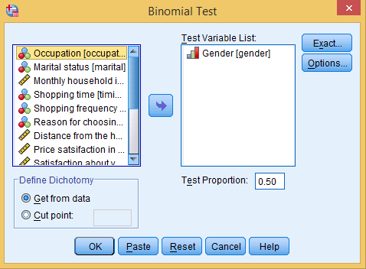
Exhibit 16.1. Use retail.sav » Analyse » Non-parametric test » Legacy Dialog » Binomial test » Select Gender and transfer into Test Variable box » Use Test Proportion 0.5 » Click OK

Slide 9
Table 16.1. Output: Binomial Test
 |  | Category | N | Observed Prop. | Test Prop. | Exact Sig. (2-tailed)
Gender | Group 1 | Male | 75 | 0.63 | 0.50 | 0.008
 | Group 2 | Female | 45 | 0.38
 | Total |  | 120 | 1.00
The p-value is less than 5 per cent LoS (p < 0.05, 0.008). Consequently, there is sufficient evidence to reject the null hypothesis and conclude that there is significantly greater proportion of male than the female category.

Slide 10
Binomial Test: Scale Variable
Null hypothesis H₀: P = 0.5
(The category of customers reaching in the departmental store for less and more than 6 km is same.)
Alternative hypothesis H_{a}: P ≠ 0.5
(The category of customers reaching the departmental store for less and more than 6 km is not same.)

Slide 11
Binomial Test: Dichotomy Option
Table 16.2. Binomial Test: Dichotomy Option
 |  | Category | N | Observed Prop. | Test Prop. | Exact Sig. (2-tailed)
Distance from the home | Group 1 | <= 6 | 77 | 0.64 | 0.50 | 0.002
 | Group 2 | >6 | 43 | 0.36
 | Total |  | 120 | 1.00
The p-value associated with this test is less than 5 per cent LoS (p < 0.05, 0.002). Thus, there is sufficient evidence to reject the null hypothesis and conclude that the proportion for these two groups is not the same. Hence, we can conclude that there is greater proportion of customers that cover the distance equal or less than 6 km.

Slide 12
Chi-Square: Test of Association
The test is used to ascertain whether one categorical variable is dependent on another or not. Thus, it is used to examine the association between the nominal variables.
Data set retail.sav is used to examine whether shopping time in the departmental store is independent to the gender. The following null and alternative hypothesis are framed.
Null hypothesis H₀: The shopping time is independent to a particular gender.
Alternative hypothesis H_{a}: The shopping time is not independent to a particular gender.

Slide 13
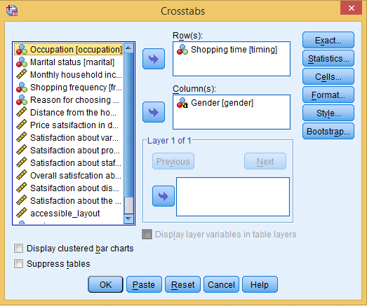
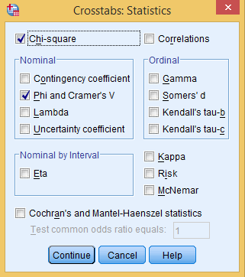
Exhibit 16.2. Use retail.sav » Analyse » Descriptive statistics » Cross tabs » Select Shopping time and transfer into Row(s) box » Select Gender and transfer into Column(s) box » Click Cells » Expected » Click Statistics » Select Chi-square and Phi and Cramer’s V in Nominal area » Continue » Click OK

Slide 14
Outputs
Table 16.3. Cross-Tabulation: Shopping Time and Gender
 |  |  | Gender |  | Total
 |  |  | Male | Female
Shopping time | Early in the morning | Count | 20 | 13 | 33
 |  | Expected count | 20.6 | 12.4 | 33.0
 | Afternoon | Count | 6 | 8 | 14
 |  | Expected count | 8.8 | 5.3 | 14.0
 | Evening | Count | 14 | 5 | 19
 |  | Expected count | 11.9 | 7.1 | 19.0
 | Late evening hours | Count | 30 | 16 | 46
 |  | Expected count | 28.8 | 17.3 | 46.0
 | Not fixed | Count | 5 | 3 | 8
 |  | Expected count | 5.0 | 3.0 | 8.0
Total |  | Count | 75 | 45 | 120
 |  | Expected count | 75.0 | 45.0 | 120.0

Slide 15
Chi-Square Statistic
Table 16.4. Chi-Square Statistic
 | Value | df | Asymp. Sig. (2-sided)
Pearson chi-square | 3.514ª | 4 | 0.476
Likelihood ratio | 3.476 | 4 | 0.482
No of valid cases | 120
ª1 cells (10.0%) have expected count less than 5. The minimum expected count is 3.00.
A p-value associated with this test is more than 5 per cent LoS (Chi-square = 3.5 (4), p > 0.05, 0.476). Thus, we fail to reject the null hypothesis of no-relationship between the two variables.

Slide 16
Table 16.5. Test of Association: Symmetric Measures
 |  | Value | Approx Sig.
Nominal by nominal | Phi | 0.171 | 0.476
 | Cramer's V | 0.171 | 0.476

Slide 17
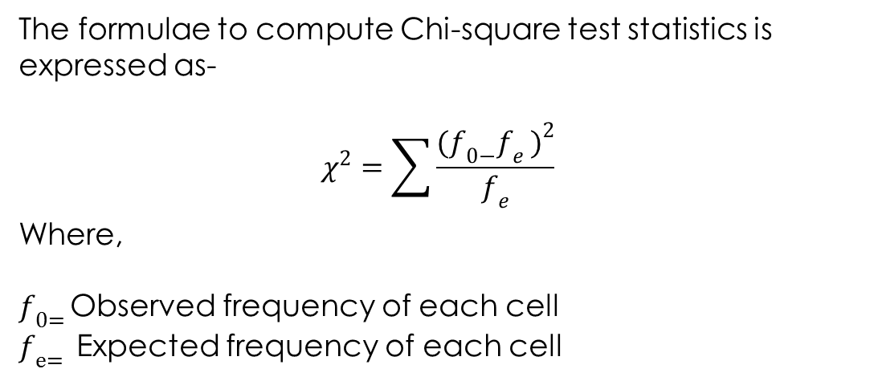

Slide 18
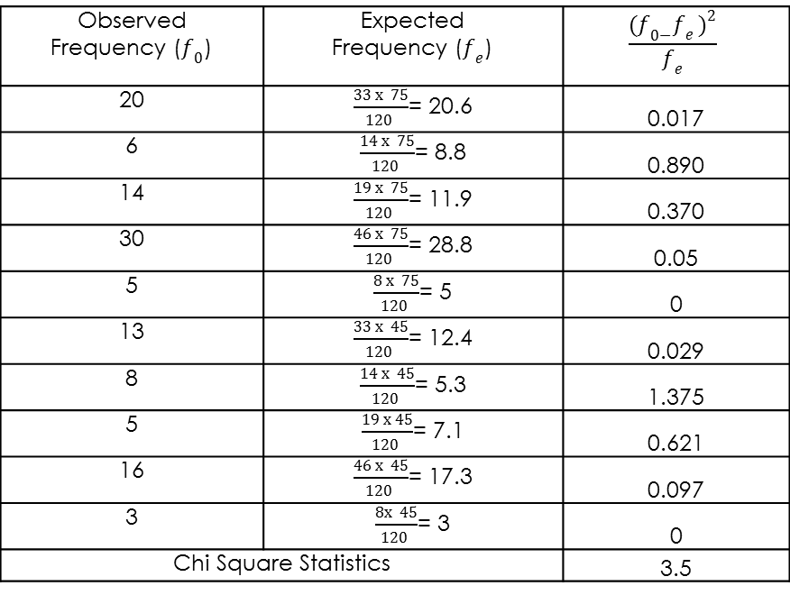
Calculations in Chi-Square
Table 16.6. Calculations: Chi-Square Test
20 |  | 0.017
6 |  | 0.890
14 |  | 0.370
30 |  | 0.05
5 |  | 0
13 |  | 0.029
8 |  | 1.375
5 |  | 0.621
16 |  | 0.097
3 |  | 0
Chi-square statistics |  | 3.5

Slide 19
Chi-Square: Goodness of Fit
The test is used to determine whether the sample distribution fit to a particular hypothesized distribution in order to make inferences for target population.
It is used to assess whether the distribution of cases belonging to a categorical variable differs from the expected frequency.

Slide 20
Goodness of Fit: Equal Distribution
Null hypothesis H₀: The frequency of customers at different shopping time is same.
Alternative hypothesis H_{a}: The frequency of customers at different shopping time is not same.

Slide 21
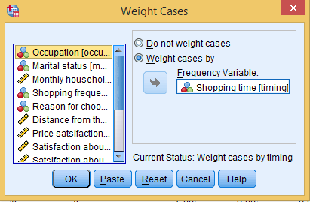
Exhibit 16.3. Use retail.sav » Data » Weight Cases » Select option Weight cases by » Transfer Shopping time in Frequency Variable box » Click OK

Slide 22
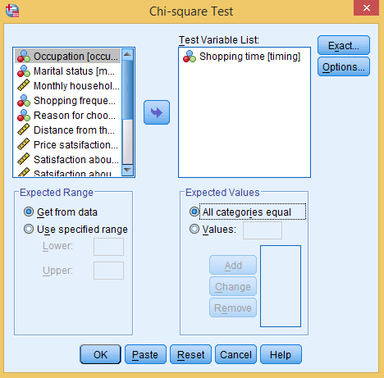
Exhibit 16.4. Use retail.sav » Analyse » Non-parametric tests » Legacy Dialogs » Chi square » Select Shopping time and transfer into Test Variable List » Select All Categories equal option » Click OK

Slide 23
Table 16.7. Descriptive Statistics: Goodness of Fit
 | Observed N | Expected N | Residual
Early in the morning | 33 | 68.4 | −35.4
Afternoon | 28 | 68.4 | −40.4
Evening | 57 | 68.4 | −11.4
Late evening hours | 184 | 68.4 | 115.6
Not fixed | 40 | 68.4 | −28.4
Total | 342

Slide 24
Table 16.8. Chi-Square Statistics: Goodness of Fit
 | Shopping time
Chi-square | 251.246ª
Df | 4
Asymp. Sig. | 0.000
ªZero cells (0.0%) have expected frequencies less than 5. The minimum expected cell frequency is 68.4.
The p-value associated with this test is less than 5 per cent LoS (Chi-square = 251.25 (4), p < 0.05, 0.000). Thus, we reject the null hypothesis of equal frequency of customers at different shopping time.

Slide 25
Goodness of Fit: Unequal Distribution
Null hypothesis H₀: Proportion of students liking different pedagogy is same as hypothesized proportion.
Alternative hypothesis H_{a}: Proportion of students liking different pedagogy is not same as hypothesized proportion.

Slide 26
Table 16.9. Dataset: Pedagogy
Role Play | Simulation | Traditional Method | Case Study Approach
5% | 30% | 50 % | 15%
Exhibit 16.5. Use pedadogy.sav » Data » Weight Cases » Select option Weight cases by » Transfer Preference into Frequency analysis box » Click OK

Slide 27
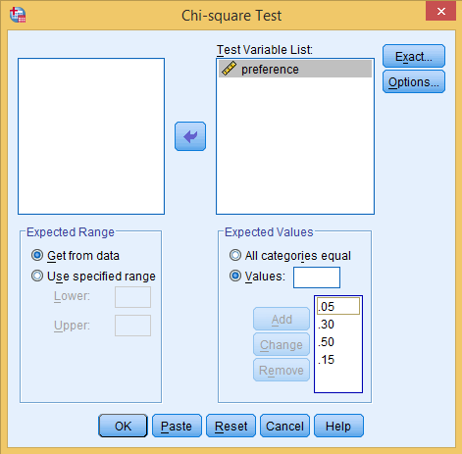
Exhibit 16.6. Use pedagogy.sav » analyse » Non-parametric tests » Legacy Dialogs » Chi-square » Select preference and transfer into Test Variable List » Select Values option in Expected Values box » Type 0.05 and click Add then type again 0.30 » Click Add (follow the same for all expected proportions) » Press OK

Slide 28
Table 16.10. Descriptive Statistics: Chi Square
 | Observed N | Expected N | Residual
26.00 | 26 | 8.0 | 18.0
35.00 | 35 | 48.0 | −13.0
45.00 | 45 | 80.0 | −35.0
54.00 | 54 | 24.0 | 30.0
Total | 160

Slide 29
Table 16.11. Chi-Square Statistics
 | Preference
Chi-Square | 96.833ª
Df | 3
Asymp. Sig. | 0.000
ªZero cells (0.0%) have expected frequencies less than 5. The minimum expected cell frequency is 8.0.
The p-value associated with chi-square test is less than 5 per cent LoS (chi-square = 96.833 (3), p < 0.05, 0.000). Thus, we reject the null hypothesis of no difference between the observed and expected proportions.
Thus, we have strong evidence that the actual proportion of students liking different pedagogy is different from the hypothesized proportion.

Slide 30
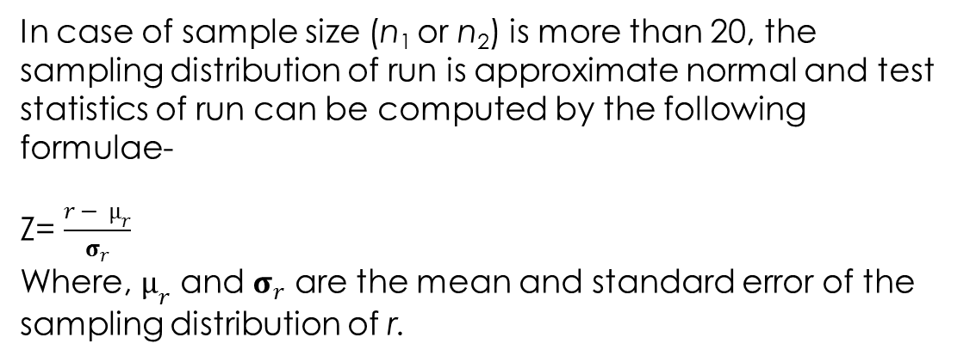
Run Test
This test is used to examine the randomness in the observations. The test is also used to check whether a sample is randomly selected from the target population or not.
Run Test for Dichotomous Variable

Slide 31
Data set retail.sav to examine the randomness in the elements of gender
Null hypothesis H₀: The order of male and female customers is randomly distributed.
Alternative hypothesis H_{a}: The order of male and female customers is not randomly distributed.
Exhibit 16.7. Use retail.sav » analyse » Non-parametric tests » Legacy Dialogs » Run test » Select Gender and transfer into Test Variable List » Select Median and Custom options in Cut point area » Type 2 in Custom box » Click OK

Slide 32
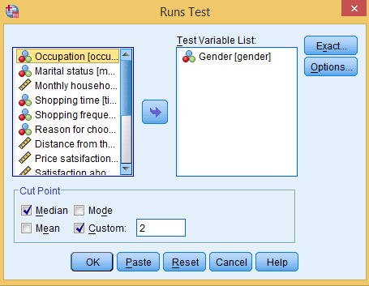

Slide 33
Table 16.12. Run Test Statistic: Dichotomous Data
 | Gender
Test valueª | 2.00
Total cases | 120
Number of runs | 88
Z | 6.01
Asymp. Sig. (2-tailed) | 0.000
ªUser-specified.
The asymptotic p-value associated with this test is less than 5 per cent LoS (Z test = 6.01, p < 0.05, 0.000). Thus, we reject the null hypothesis of randomness for male and female genders. Thus, the order of male and female gender does not appear randomly.

Slide 34
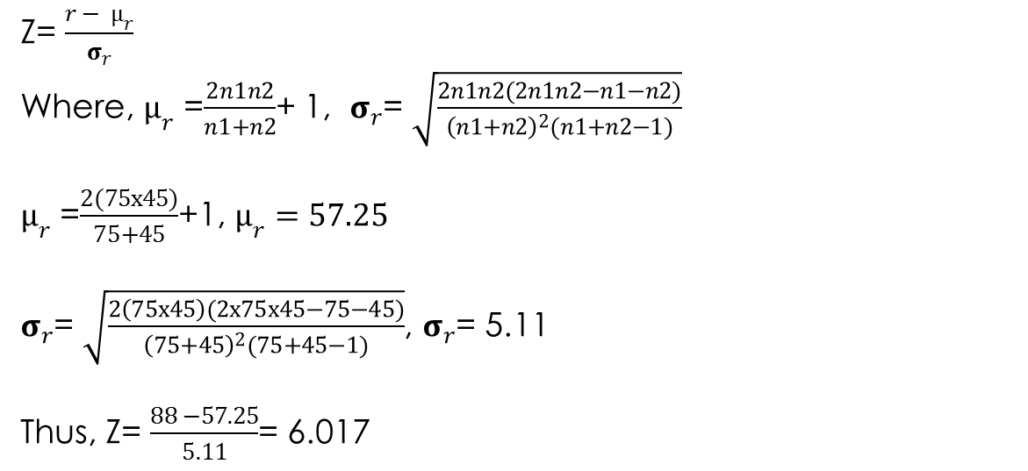
Calculations

Slide 35
Run Test for Scale Variable
The run test can also be used to ascertain whether randomness is present in data based on the scale variable.
In order to find the same, the median is calculated for the scale variable and assign ‘+’ and ‘−’ signs for above and below the observations respectively from the median.
Null hypothesis H₀: The distance covered by the customers is randomly distributed.
Alternative hypothesis H_{a}: The distance covered by the customers is not randomly distributed.

Slide 36
Table 16.13. Run Test Statistic: Scale Data
 | Distance from the Home
Test value | 5.00
Cases < Test value | 38
Cases >= Test value | 82
Total cases | 120
Number of runs | 46
Z | −1.471
Asymp. Sig. (2-tailed) | 0.141
The asymptotic p-value associated with this test is more than 5 per cent LoS (Z test = −1.471, p > 0.05, 0.141). Thus, we fail to reject the null hypothesis of randomness in distance and conclude that the distance covered by the customers is randomly distributed.

Slide 37
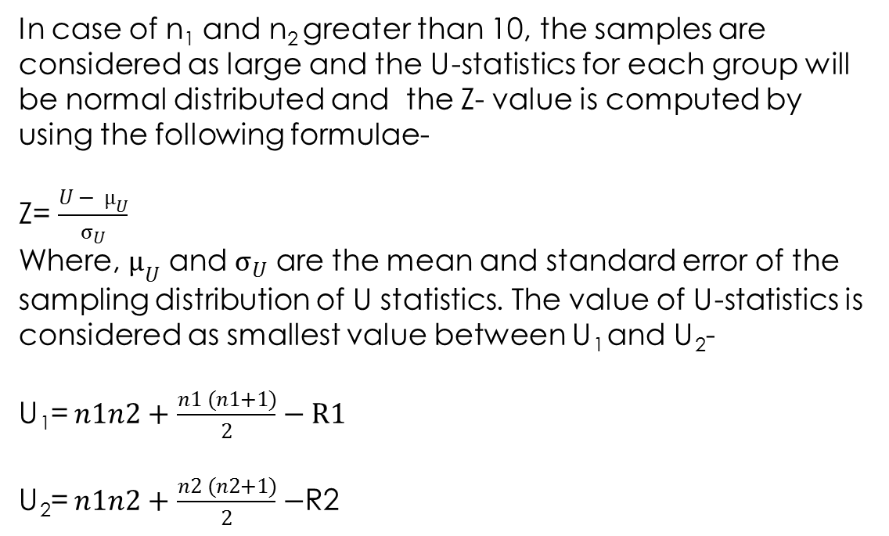
Two-Independent Sample Test: Mann Whitney U-Test
It is a substitute of independent sample t-test in case the population is not normally distributed and the sample size is small. This test is used to ascertain the difference of dependent variable between two distinct populations (Milencovic 2011).

Slide 38
Exhibit 16.8. Use retail.sav » analyse » Non-parametric tests » Legacy Dialogs » Two-Independent Sample Tests » Select Distance and transfer into Test Variable List » Select Gender and transfer into Grouping Variable box » Click Define Groups » Type 1 and 2 in box Group 1 and Group 2, respectively » Continue » Press OK

Slide 39
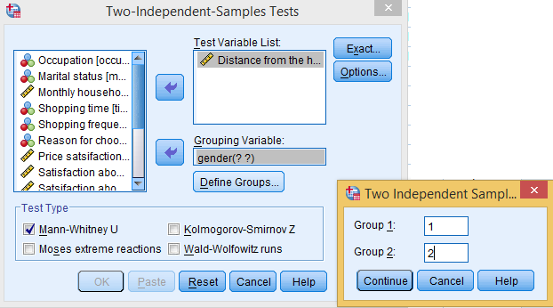
Null hypothesis H₀: The distance covered by male and female customers is same.
Alternative hypothesis H_{a}: The distance covered by male and female customers is not same.

Slide 40
Table 16.14. Rank Sums: Two Groups
 | Gender | N | Mean Rank | Sum of Ranks
Distance from home | Male | 75 | 62.51 | 4688.50
 | Female | 45 | 57.14 | 2571.50
 | Total | 120

Slide 41
Table 16.15. Test Statistics: Mann–Whitney U
 | Distance from the home
Mann–Whitney U | 1536.500
Wilcoxon W | 2571.500
Z | −0.827
Asymp. Sig. (2-tailed) | 0.408
The asymptotic p-value associated with this test is more than 5 per cent LoS (Z test = − 0.827, p > 0.05, 0.408). We fail to reject the null hypothesis of no difference in distance between two distinct groups.

Slide 42
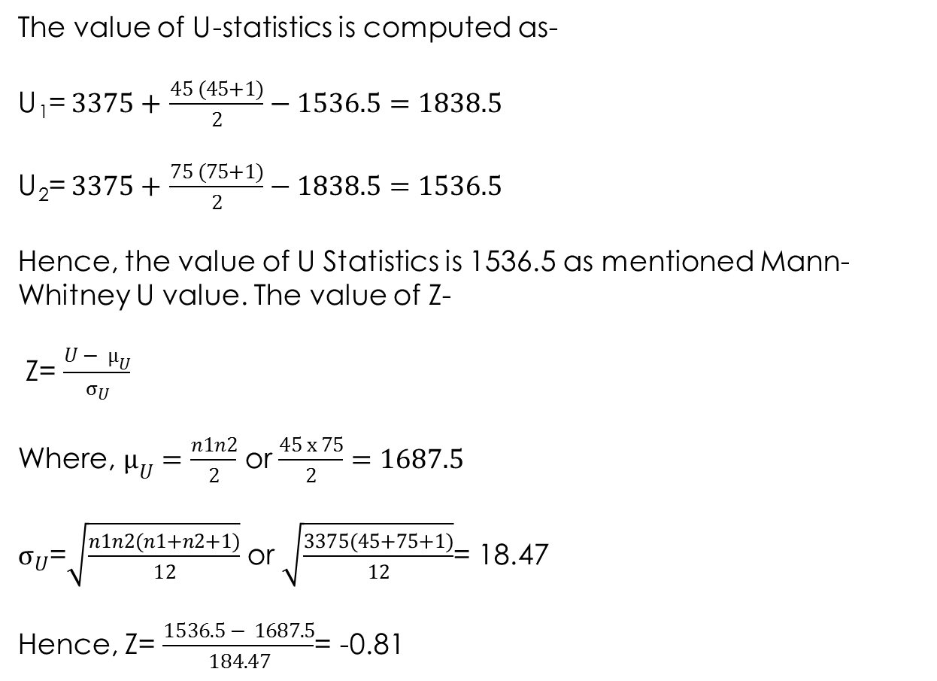
Calculations

Slide 43
Kruskal–Wallis H-Test
The test is a substitute of ANOVA in case when the population is not normally distributed is used to compare several groups of populations in completely randomized design experiment.
Sums of ranks of k samples are used to compare the population groups (Kurucova, Medova and Tirpacova 2018). The observations are required to convert into rank order instead of scale or continuous for computing this test.
Exhibit 16.9. Use coffee_drinks » analyse » Non-parametric tests » Legacy Dialogs » K-independent sample tests » Select Quality and transfer into Test Variable List » Select Coffee and transfer into Grouping Variable box » Click Define groups » Type 1 and 3 in box Minimum and Maximum, respectively » Continue » Press OK

Slide 44
Null hypothesis H₀: All k-independent groups have identical distribution.
Alternative hypothesis H_{a}: The k-independent groups do not have identical distribution.

Slide 45
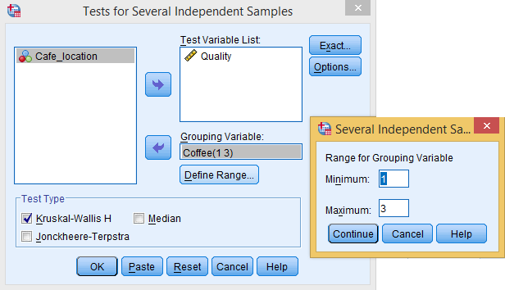
Table 16.16. Mean Rank: Category-Wise
 | Coffee | N | Mean Rank
Quality | Cappuccino | 35 | 54.19
 | Macchiato | 35 | 43.94
 | Americano | 35 | 60.87
 | Total | 105

Slide 46
Table 16.17. Chi-Square Statistics: Kruskal–Wallis Test
 | Quality
Chi-Square | 5.5
Df | 2
Asymp. Sig. | 0.062
The asymptotic p-value associated with this test is more than 5 per cent LoS (χ² test = 5.5, p < 0.05, 0.062) at 3 (k−1, 3 − 1 = 2) degrees of freedom. Thus, we fail to reject the null hypothesis of identical distribution and conclude that no difference exists in the quality of coffee drinks among the experiment groups.

Slide 47
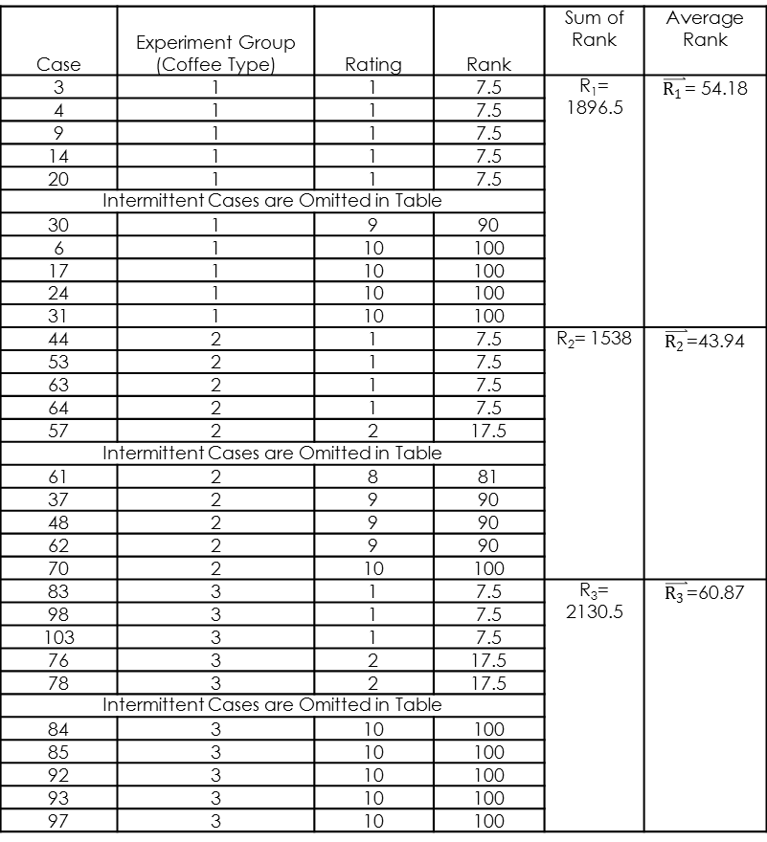
Sample Data and Mean Scores
Case | Experiment Group (Coffee Type) | Rating | Rank | Sum of Rank | Average Rank
3 | 1 | 1 | 7.5 | R₁= 1896.5
4 | 1 | 1 | 7.5
9 | 1 | 1 | 7.5
14 | 1 | 1 | 7.5
20 | 1 | 1 | 7.5
Intermittent cases are omitted in table
30 | 1 | 9 | 90
6 | 1 | 10 | 100
17 | 1 | 10 | 100
24 | 1 | 10 | 100
31 | 1 | 10 | 100
44 | 2 | 1 | 7.5 | R₂= 1538
53 | 2 | 1 | 7.5
63 | 2 | 1 | 7.5
64 | 2 | 1 | 7.5
57 | 2 | 2 | 17.5
Intermittent cases are omitted in table
61 | 2 | 8 | 81
37 | 2 | 9 | 90
48 | 2 | 9 | 90
62 | 2 | 9 | 90
70 | 2 | 10 | 100
83 | 3 | 1 | 7.5 | R₃= 2130.5
98 | 3 | 1 | 7.5
103 | 3 | 1 | 7.5
76 | 3 | 2 | 17.5
78 | 3 | 2 | 17.5
Intermittent cases are omitted in table
84 | 3 | 10 | 100
85 | 3 | 10 | 100
92 | 3 | 10 | 100
93 | 3 | 10 | 100
97 | 3 | 10 | 100

Slide 48
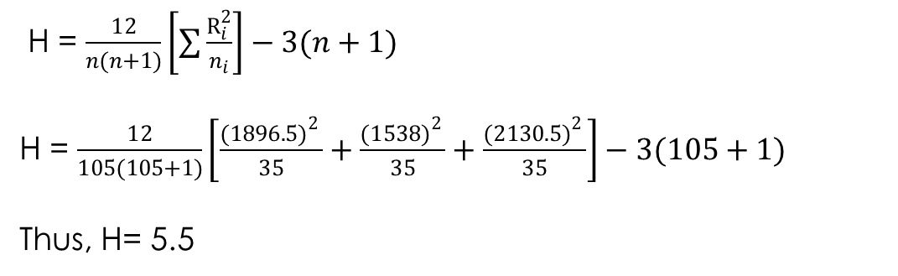

Slide 49
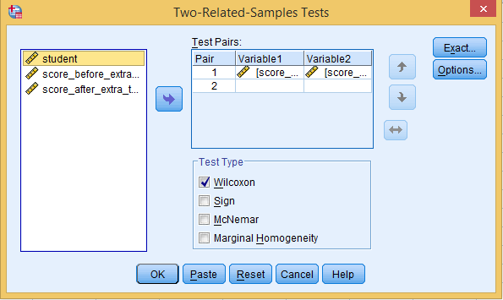
Wilcoxon Matched Pairs Test
Exhibit 16.10. Use students.sav » analyse » Non-parametric tests » Legacy Dialogs » Two-Related-Samples Tests » Select score before and score after and transfer into Test Pairs box » Select Wilcoxon as Test Type » Click OK

Slide 50
Table 16.19. Details of Negative and Positive Ranks
 |  | N | Mean Rank | Sum of Ranks
Score after extra tutorials, score before extra tutorials | Negative Ranks | 9 | 13.83 | 124.50
 | Positive Ranks | 20 | 15.53 | 310.50
 | Ties | 1
 | Total | 30

Slide 51
Table 16.20. Wilcoxon Matched Pairs Statistics
 | Difference in Score
Z | −2.014
Asymp. Sig. (2-tailed) | 0.044
The asymptotic p-value associated with this test is less than 5 per cent LoS (χ² test = −2.014, < 0.05, 0.044). Thus, we reject the null hypothesis of no difference in mean score before and after the tutorials and conclude that significant difference exists between the scores.

Slide 52
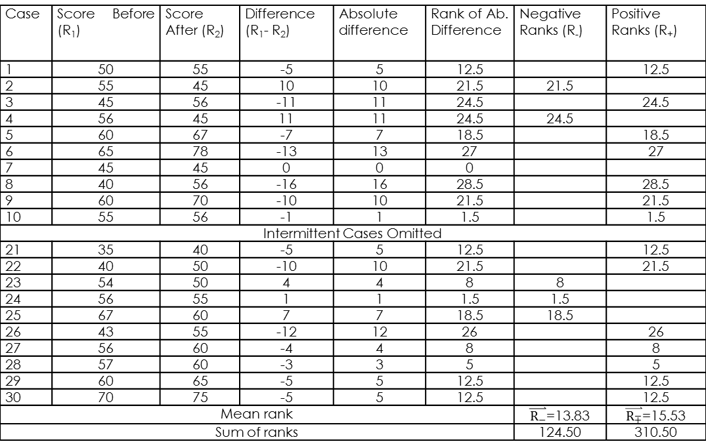
Sample Data and Mean Scores
Table 16.21. Absolute Differences: Wilcoxon Matched Pairs Statistics
Case | Score Before (R₁) | Score After (R₂) | Difference (R₁−R₂) | Absolute Difference | Rank of Ab. Difference | Negative Ranks (R₋) | Positive Ranks (R₊)
1 | 50 | 55 | −5 | 5 | 12.5 |  | 12.5
2 | 55 | 45 | 10 | 10 | 21.5 | 21.5
3 | 45 | 56 | −11 | 11 | 24.5 |  | 24.5
4 | 56 | 45 | 11 | 11 | 24.5 | 24.5
5 | 60 | 67 | −7 | 7 | 18.5 |  | 18.5
6 | 65 | 78 | −13 | 13 | 27 |  | 27
7 | 45 | 45 | 0 | 0 | 0
8 | 40 | 56 | −16 | 16 | 28.5 |  | 28.5
9 | 60 | 70 | −10 | 10 | 21.5 |  | 21.5
10 | 55 | 56 | −1 | 1 | 1.5 |  | 1.5
Intermittent cases are omitted
21 | 35 | 40 | −5 | 5 | 12.5 |  | 12.5
22 | 40 | 50 | −10 | 10 | 21.5 |  | 21.5
23 | 54 | 50 | 4 | 4 | 8 | 8
24 | 56 | 55 | 1 | 1 | 1.5 | 1.5
25 | 67 | 60 | 7 | 7 | 18.5 | 18.5
26 | 43 | 55 | −12 | 12 | 26 |  | 26
27 | 56 | 60 | −4 | 4 | 8 |  | 8
28 | 57 | 60 | −3 | 3 | 5 |  | 5
29 | 60 | 65 | −5 | 5 | 12.5 |  | 12.5
30 | 70 | 75 | −5 | 5 | 12.5 |  | 12.5
Mean rank
Sum of ranks |  |  |  |  |  | 124.50 | 310.50

Slide 53
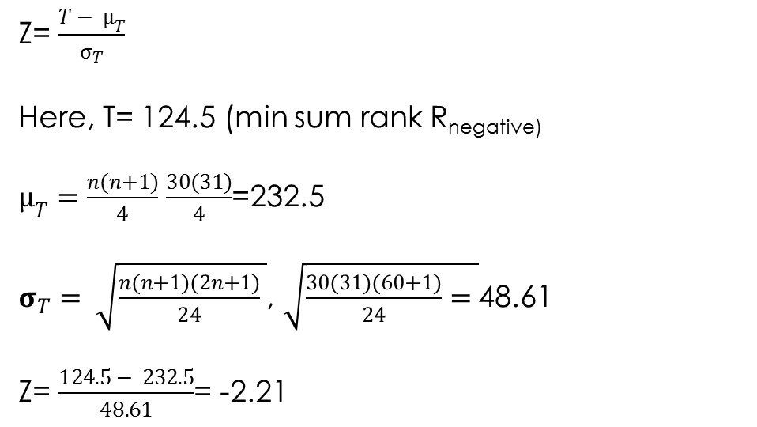
Calculation

Slide 54
Required Scale and Measurement for Non-Parametric Tests
Task | Number of Variable(s) Required | Purpose of Test | Required Scale
Binomial test procedure | 1 | Examine an expected proportion of a dichotomous variable | Either nominal consisting of two categories or scale variable
Chi-square as test of association | 2 | Whether the variables are independent to each other | Both nominal based and has two or more than two categories
Chi-square as goodness-of-fit: Equal distribution | 1 | Examine whether sample distribution fit to a particular hypothesized distribution in equal proportion | One nominal and has two or more than two categories
Chi-square as goodness-of-fit: Unequal distribution | 1 | Whether sample distribution fit to a particular hypothesized distribution and as equal proportion
Run test for dichotomous variable | 1 | Examine the randomness in two mutually exclusive events
Run test for scale variable | 1 | Examine the randomness in data based on continuous scale | One variable continuous in nature
Mann–Whitney U-test | 2 | Examine the difference between two distinct populations | Independent variable is nominal and dependent variable is converted into rank order
Kruskal–Wallis H-test | 2 | Examine the difference among more than two distinct populations | Independent variable is nominal (having more than two categories) and dependent variable is ordinal based
Wilcoxon matched pairs test | 2 | Examine the difference between matched population | One dependent variable is repeated in nature measured as rank order

Slide 55
Key Terms
Binomial Test Completely randomized design Contingency table Expected frequency Goodness of fit test Kruskal-Wallis H-Test Mann Whitney U-Test Non-parametric tests | Normal distribution Observed frequency Repeated observation Run test Runs Test of Association Wilcoxon Matched Pairs Test

